Slide 1
CpE 319
Dr. Ann Miller
Computer and Network Security Attacks
24 March 2005

Slide 2
Outline
Increasing importance
Some terminology
Security attacks
  Classification schemes
  Classical attacks
Anatomy of a network attack

Slide 3
Importance
Data from PITAC Report, 12 Jan 2005
The number of new vulnerabilities discovered in software is growing at 140% per year. (CERT)
The average time between disclosure of a vulnerability and release of an associated exploit has dropped to 5.8 days. (Symantec)

Slide 4
Importance
Data from PITAC Report, 12 Jan 2005
The rate at which new hosts are “zombied” rose from 2,000 per day to 30,000 per day during the first 6 months of 2004. (Symantec)
Hostile (worm) traffic originated from 40% of the networks controlled by Fortune 100 companies in first half of 2004, despite the fact that these companies have protective measures. (Symantec)

Slide 5
Importance
Data from PITAC Report, 12 Jan 2005
83% of financial institutions experienced compromised systems in 2003, more than double the rate in 2002. (Deloitte)
17% of 100 companies surveyed reported being the target of cyber extortion. (CMU per Information Week)

Slide 6
Importance
Data from PITAC Report, 12 Jan 2005
The number of unique phishing attacks is doubling every month with 2000 different attacks perpetrated against users in July 2004 alone. (Anti-Phishing Working Group)
1% of US households fell victim to phishing attacks in early 2004, at a cost of over $400M in direct monetary losses. (Consumers Union)

Slide 7
Terminology
Information assurance comprises those measures to protect and defend information and information systems by ensuring their availability, integrity, authenticity, confidentiality, and non-repudiation.
Computer network defense comprises those actions taken to plan and direct responses to unauthorized activity in defense of networked information systems.

Slide 8
Terminology
Computer network attack comprises those operations conducted using information systems to disrupt, deny, degrade or destroy information resident in computer and networks, or, the computers and networks themselves.
Computer network exploitation comprises those actions that result in the ability to gather information about a network or the systems or users on that network.

Slide 9
Terminology
A threat is traditionally defined as a capability linked to hostile intent.
  “Linking capability to intent works well when malefactors are clearly discernible … Today, however, malefactors are no longer necessarily nation-states, and expensive weapons of war are joined by means that are easier to acquire, harder to detect, and have legitimate peacetime applications. The tools designed to access, manipulate, and manage the information or communications components that control critical infrastructures can also be used to do harm. They are inexpensive, readily available, and easy to use.”
  President’s Commission on Critical Infrastructure Protection

Slide 10
Threats
Threats can be characterized on a continuum from script kiddies to organized nation-states or groups whose goal is Offensive Information Warfare.
  Somewhere in between, depending on level of expertise, are:
    Hackers driven by technical challenge
    Disgruntled employees
    Crooks seeking financial gain
    Organized crime
    Foreign espionage
    Cryptovirologists

Slide 11
Security Attacks
Can be classified from several different viewpoints
A high level framework would classify by physical vs. social engineering vs. software

Slide 12
Physical Attacks
Wiretapping
Key logging (H/W)
  There is a software variant with spyware
Vandalism

Slide 13
Social Engineering
Posing as administrator and requesting password
Posing as another user and asking for information/file/etc.
Designing clever titles for e-mail attachment viruses
  Although the actual virus is a software attack

Slide 14
Software Attacks
Can be classified from several different viewpoints
One such perspective is Active vs. Passive

Slide 15
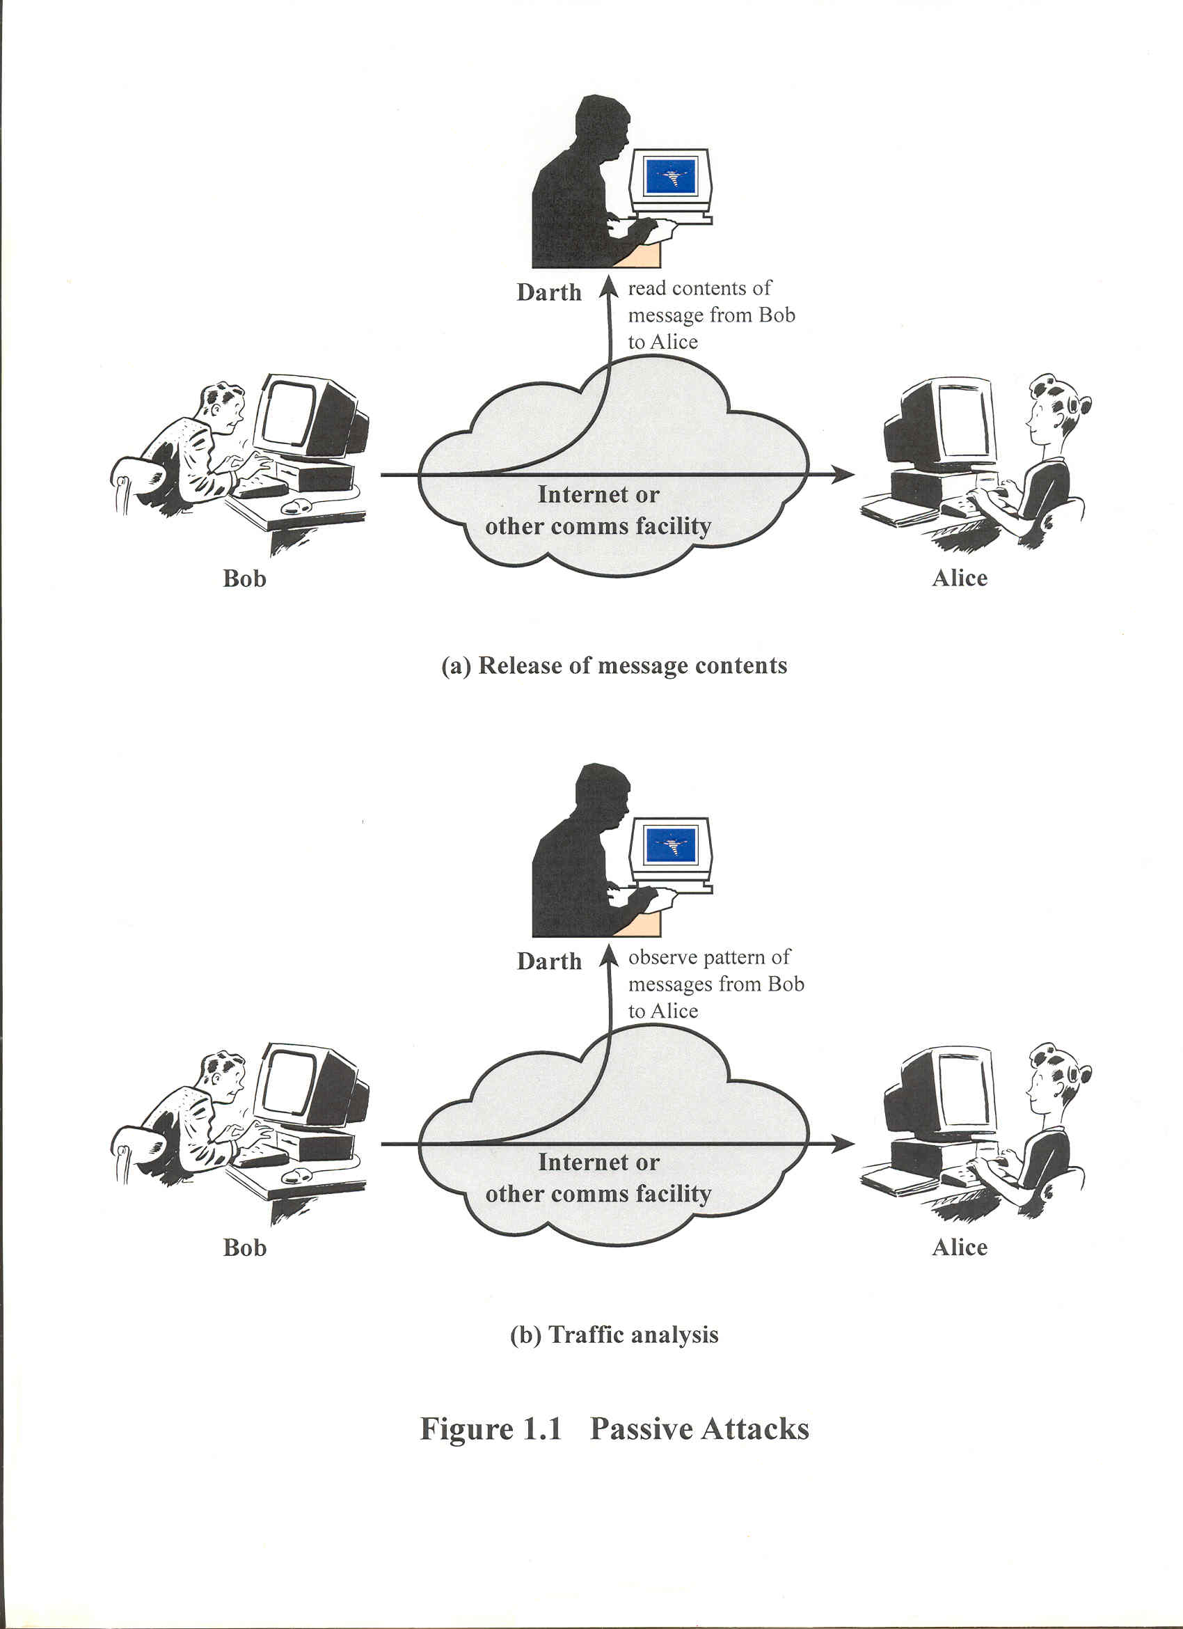
Passive Attacks

Slide 16
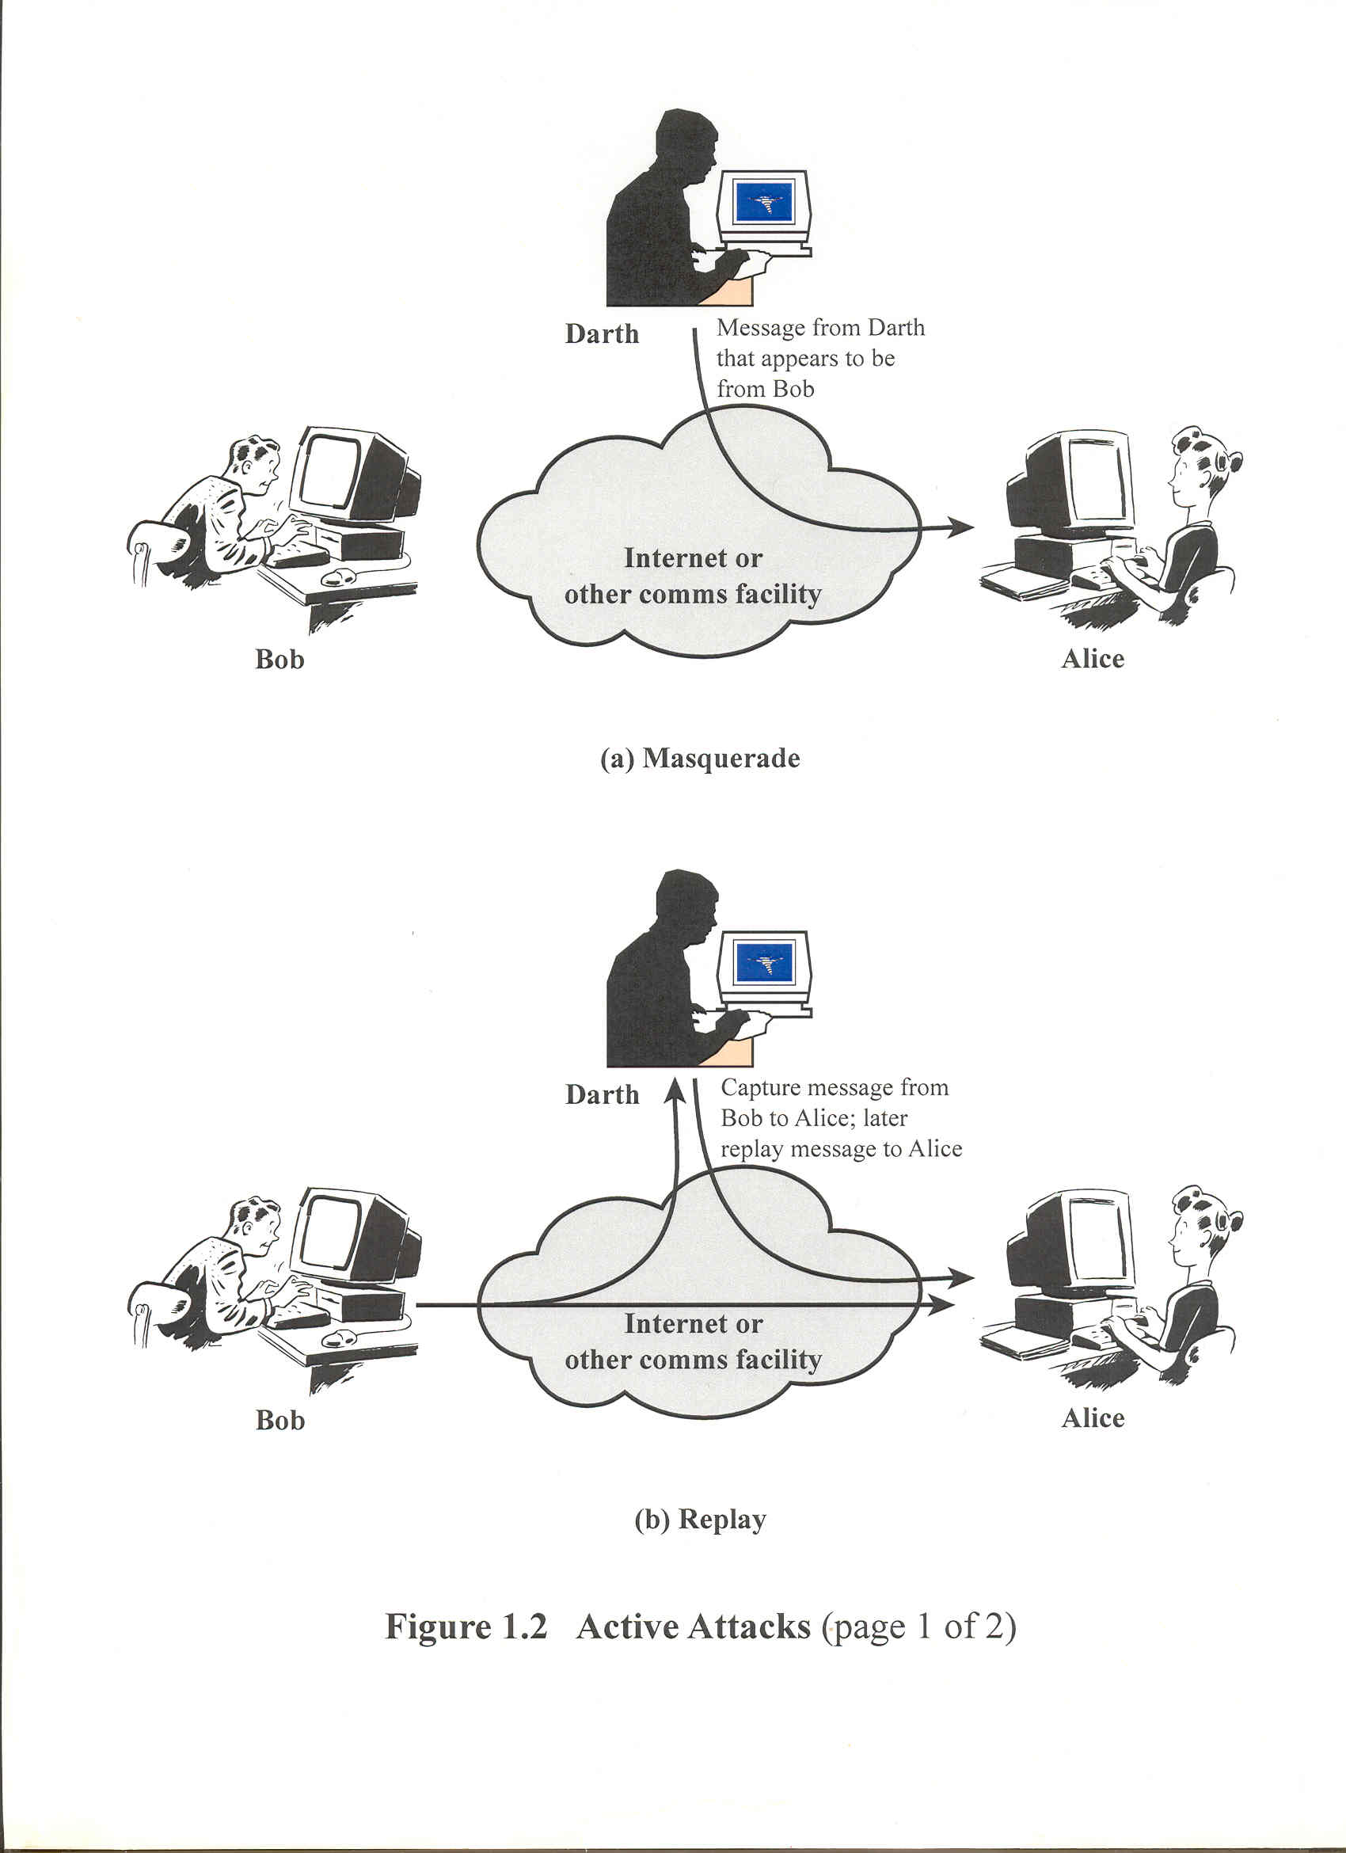
Active Attacks

Slide 17
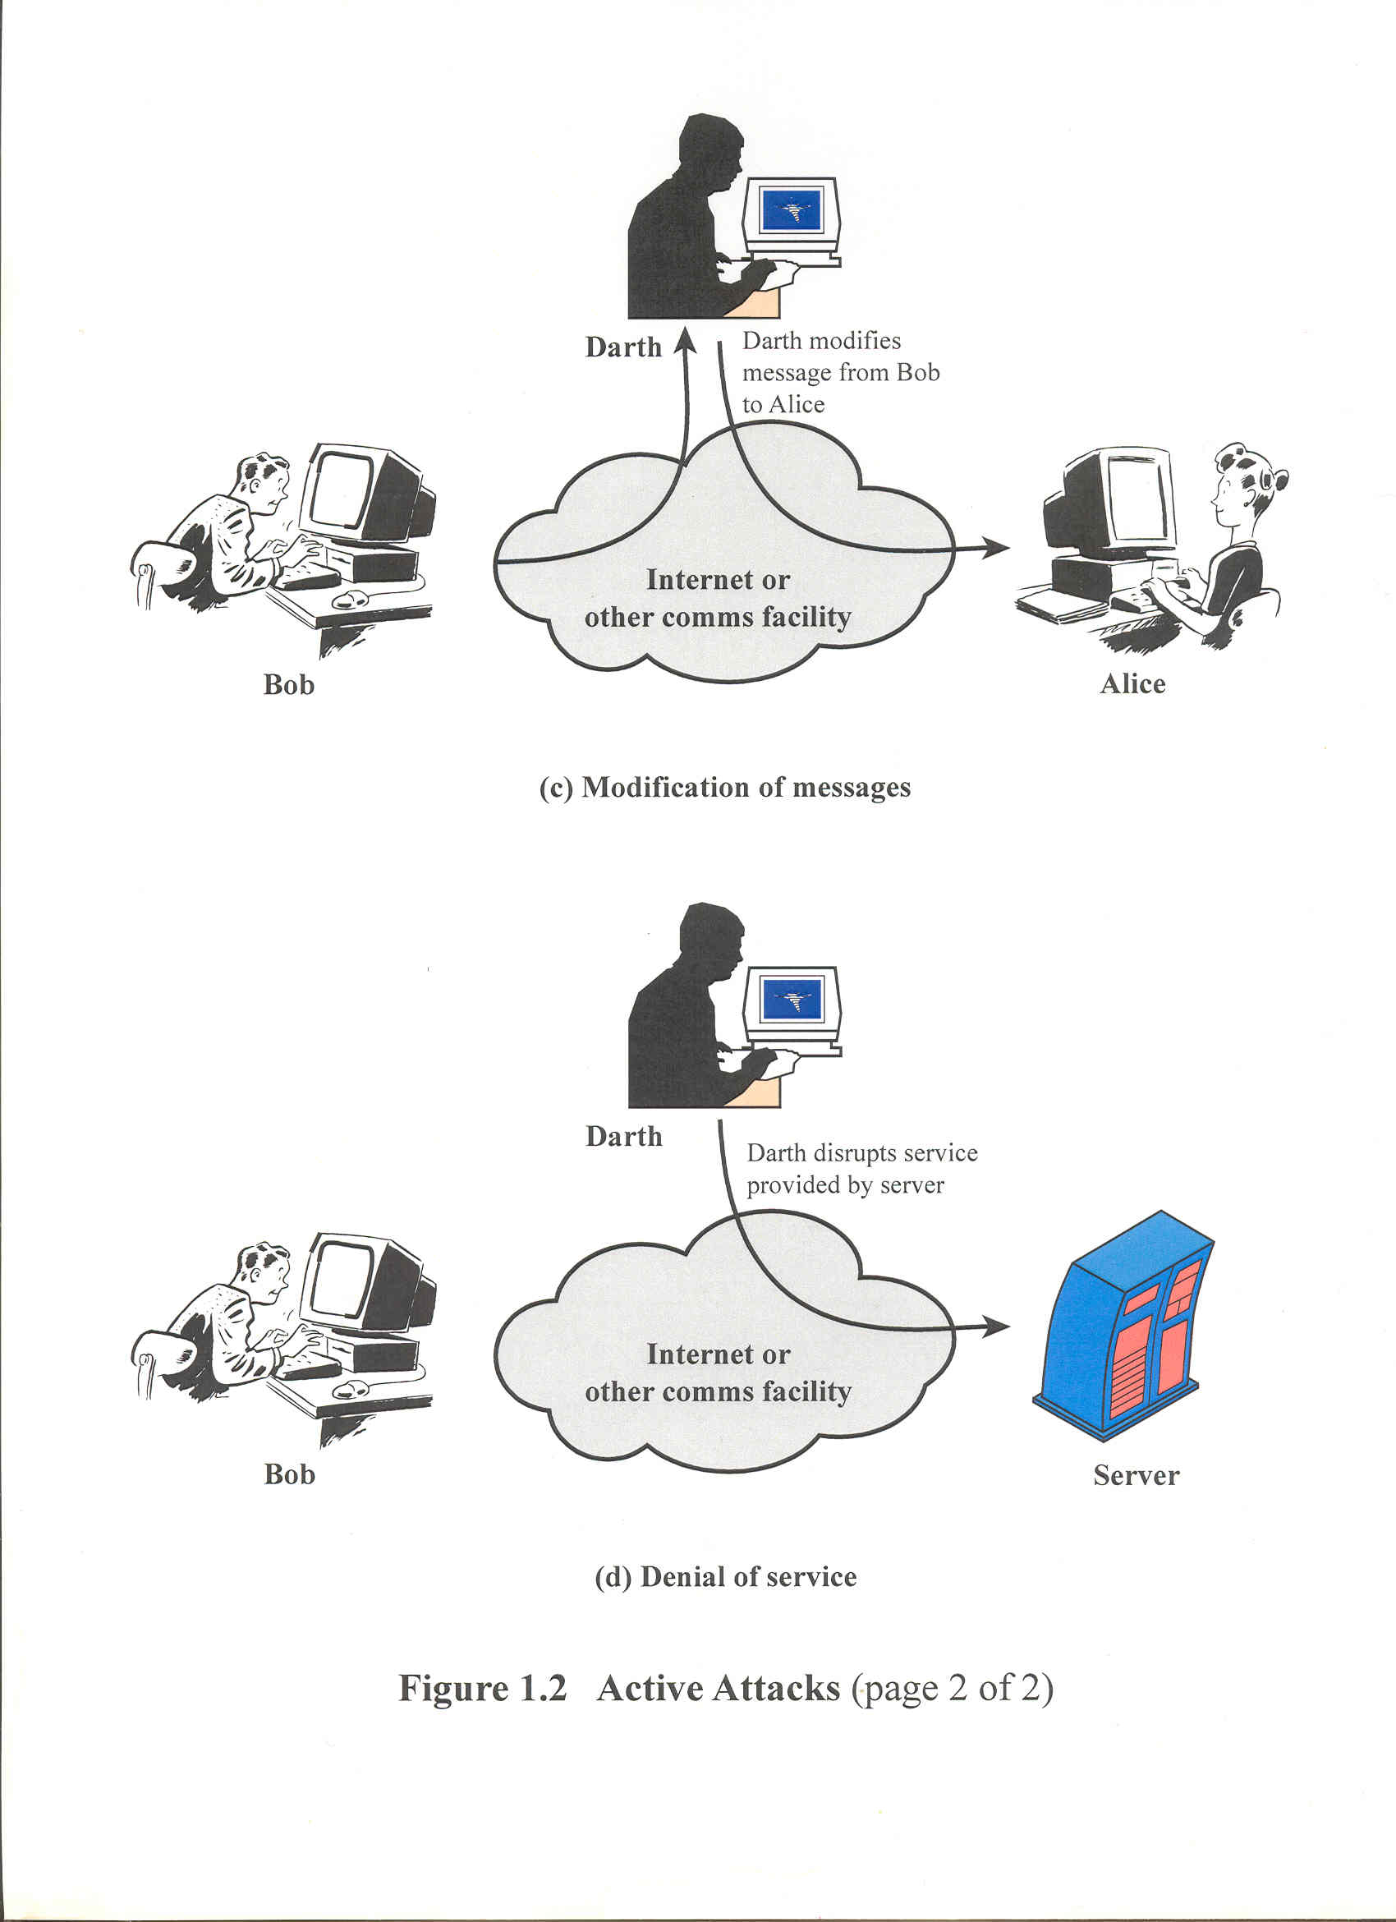
Active Attacks
(continued)

Slide 18
Security Attacks
Can be classified from several different viewpoints
Another perspective is whether there is an analytic approach or merely brute force.
  If analytic, then categorize the approach. (more in a few slides)
  If brute force, then categorize by what is being attacked: passwords, encryption keys, etc.

Slide 19
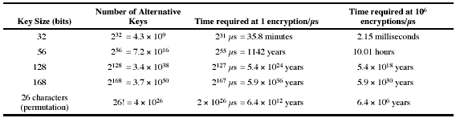
Brute Force Search
Always possible to simply try every key.
Most basic attack, proportional to key size.
Assume can recognise plaintext.

Slide 20
Prologue
Some background before considering various attacks

Slide 21
Cryptology Terminology
Encryption or enciphering is the conversion of plaintext or data into unintelligible form by means of a reversible translation (called decryption or deciphering), based on a translation table or algorithm.

Slide 22
Cryptology Terminology
(continued)
The translated plaintext is called ciphertext.
Cipher is an algorithm for encryption and decryption, by replacing an element of plaintext into another object with the intent to conceal meaning.

Slide 23
Cryptology Terminology
(continued)
Code is an unvarying rule for replacing a piece of information with another object, not necessarily of the same type.
  There may or may not be an intent to conceal meaning.

Slide 24
Cryptology Terminology
(continued)
Cryptology is the study of secure communications.
Two components:
  Cryptography
  Cryptanalysis

Slide 25
Cryptology Terminology
(continued)
Cryptography deals with the design of algorithms for encryption and decryption, intended to improve secrecy and/or authenticity of messages.

Slide 26
Cryptology Terminology
(continued)
Cryptanalysis deals with
  The breaking of a cipher to recover information, or,
  With forging encrypted information that will be accepted as authentic.

Slide 27
Symmetric Encryption
Also known as conventional / private-key / single-key
Sender and recipient share a common key
All classical encryption algorithms are private-key
Was only type prior to invention of public-key in 1970’s

Slide 28
Conventional Encryption Model
Five components:
  Plaintext
  Encryption algorithm
  Secret key
  Ciphertext
  Decryption algorithm

Slide 29

Symmetric Cipher Model

Slide 30
Requirements
Two requirements for secure use of symmetric or conventional encryption:
  A strong encryption algorithm
  A secret key known only to sender / receiver
  Y = E_{K}(X)
  X = D_{K}(Y)

Slide 31
Classical Encryption Techniques
Fundamental techniques:
  Substitution
  Transposition
  Combination of the two

Slide 32
Types of Attacks
Following table summarizes various types of cryptographic attacks:
  Ciphertext only
  Known plaintext
  Probable word
  Chosen plaintext
  Chosen ciphertext
  Chosen text

Slide 33
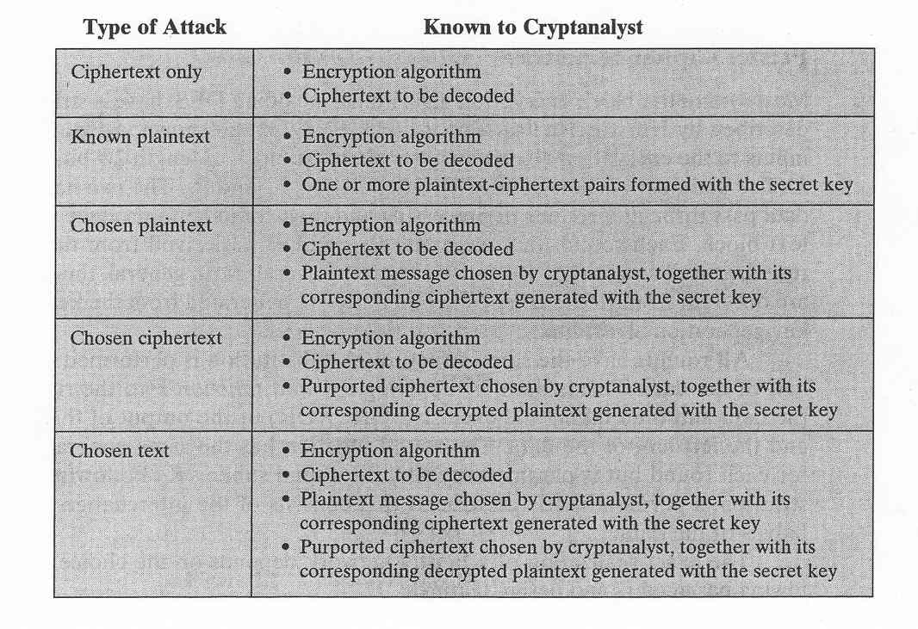
Types of Attacks on Encrypted Messages

Slide 34
Private-Key Cryptography
Traditional private/secret/single key cryptography uses one key
  Shared by both sender and receiver
  If this key is disclosed communications are compromised
  Also is symmetric, parties are equal
  Hence, does not protect sender from receiver forging a message and claiming it has been sent by sender.

Slide 35
Public-Key Cryptography
Probably most significant advance in the 3000 year history of cryptography
Uses two keys – a public key and a private key
Asymmetric since parties are not equal
Uses clever application of number theoretic concepts to function
Complements rather than replaces private-key cryptography

Slide 36
Fundamental Principle for
Asymmetric Key System
Public-key algorithms rely on one key for encryption and a different, but related, key for decryption such that it is computationally infeasible to determine the decryption key given only knowledge of the cryptographic algorithm and the encryption key.

Slide 37
Public-Key Cryptography Components
Components:
  Plaintext
  Encryption algorithm
  Public key
  Private key
  Ciphertext
  Decryption algorithm

Slide 38
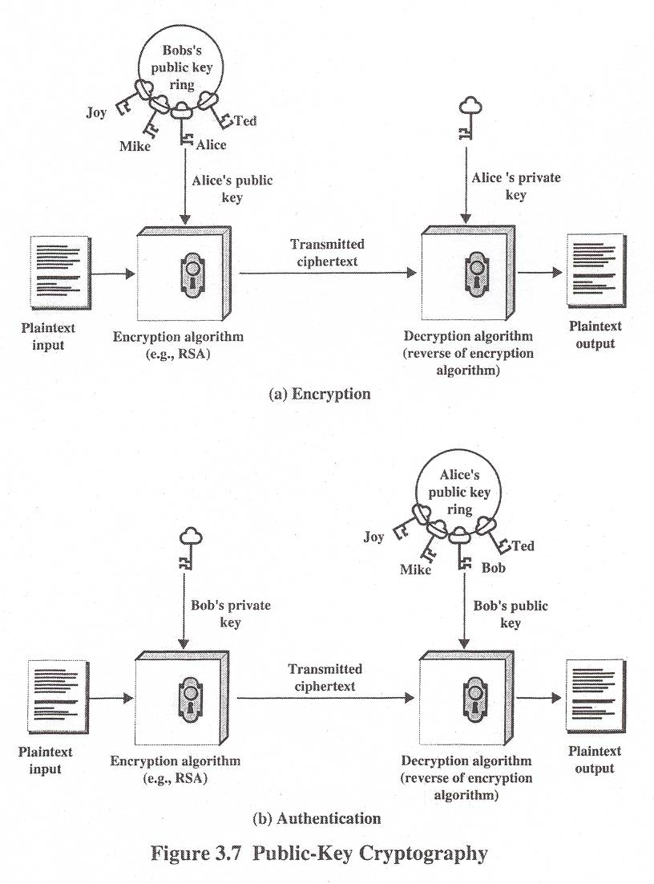

Slide 39
Public-Key Cryptography
Public-key (asymmetric) cryptography involves the use of two keys:
  A public-key, which may be known by anybody, and can be used to encrypt messages and to verify signatures
  A private-key, known only to the recipient, used to decrypt messages and to sign (create) signatures
  Is asymmetric because those who encrypt messages or verify signatures cannot decrypt messages or create signatures.

Slide 40
Security of Public Key Schemes
Like private key schemes, brute force exhaustive search attack is always theoretically possible but keys used are large (> 512bits)
Requires the use of very large numbers.
Security relies on a large enough difference in difficulty between easy (en/decrypt) and difficult (cryptanalysis) problems
Hence, is slow compared to private key schemes.

Slide 41

Public-Key Cryptosystems
Notes:
Here see various components of public-key schemes used for both secrecy and authentication. Note that separate key pairs are used for each of these – receiver owns and creates secrecy keys, sender owns and creates authentication keys.

Slide 42
Public-Key Cryptanalysis
(continued)
Vulnerability: probable-message attack
  Message to be sent is a 56-bit DES key
  Opponent could encrypt all possible keys using public key and decipher any message by matching the transmitted ciphertext.
Countermeasure: append bits.

Slide 43
Public-Key Cryptographic Algorithms
Two most widely used algorithms:
  RSA (Ron Rivest, Adi Shamir and Len Adleman at MIT) in 1977.
    Block cipher
  Diffie-Hellman (Whitfield Diffie and M. Hellman).
    Exchange a secret key securely
    Compute discrete logarithms.

Slide 44
Public-Key Cryptographic Algorithms
Two most widely used algorithms:
  RSA (Ron Rivest, Adi Shamir and Len Adleman at MIT) in 1977.
    Block cipher
  Diffie-Hellman (Whitfield Diffie and M. Hellman)
    Exchange a secret key securely
    Compute discrete logarithms

Slide 45
RSA Security
Three approaches to attacking RSA:
  Brute force key search (infeasible given size of numbers)
  Mathematical attacks (based on difficulty of computing ø(N), by factoring modulus N)
  Timing attacks (on running of decryption)

Slide 46
RSA-specific Attacks
Brute force: try all possible keys
  The larger the number of bits in e and d, then the more secure the algorithm
  But the larger the size of the key, the slower the performance.

Slide 47
RSA-specific Attacks
Prime factorization of n
  Challenge in 1977: public key length of approximately 428 bits
  In 1994, 1600 networked computers, 8 months to break

Slide 48
Timing Attacks
Developed in mid-1990’s
Exploit timing variations in operations
  e.g., multiplying by small vs large number
Infer operand size based on time taken
RSA exploits time taken in exponentiation
Countermeasures
  use constant exponentiation time
  add random delays
  blind values used in calculations

Slide 49
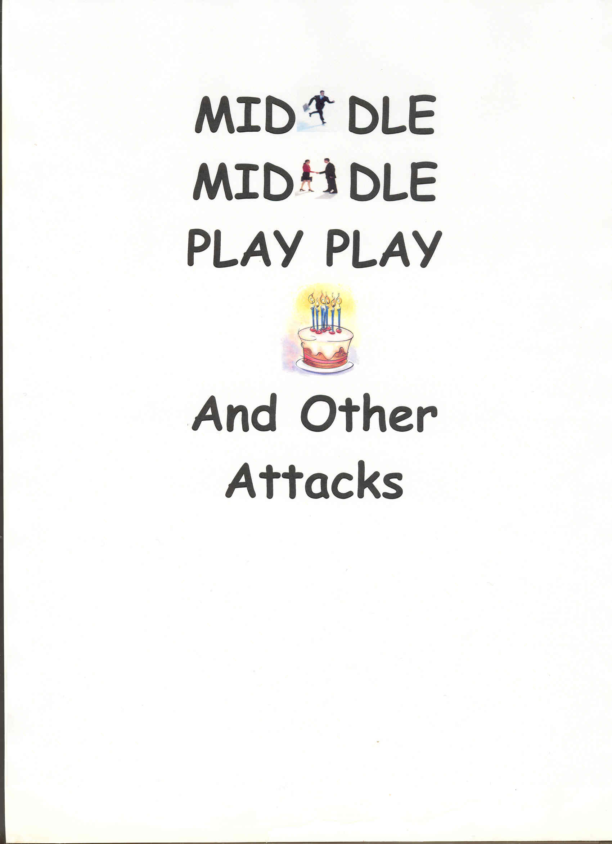
Classical Security Attacks

Slide 50
Man-in-the-Middle Attack
User A wants to communicate with user B using a public-key algorithm.
Eavesdropper E intercepts A’s communications and pretends to be user B, completing a key-exchange protocol.
E then contacts user B and pretends to be A, again completing a key-exchange protocol.
E can now eavesdrop on all conversations between A and B.

Slide 51
Approaches to Counter
Man-in-the-Middle Attacks
Strong authentication
  Easier to prevent eavesdropping and insertion/deletion attacks
  More difficult to secure against a malicious host.

Slide 52
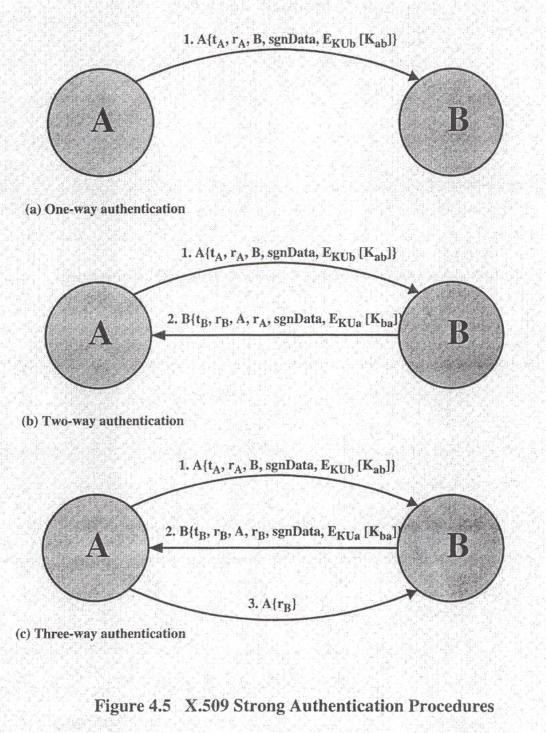

Slide 53
Meet-in-the-Middle Attack
First described by Diffie and Hellman in 1977 on DES but is applicable to any block encryption cipher
Based on observation that, if C = E_{K2}[E_{K1}[P]], then X = E_{K1}[P] = D_{K2}[C]

Slide 54
Meet-in-the-Middle Attack
Then, given a known pair, (P, C),
  Encrypt P for all 2⁵⁶ possible values of K1 (for 56-bit key)
  Store values in table and sort table by values of X
  Decrypt C using all 2⁵⁶ possible values of K2.
  As each decryption produced, check against table for match.
  If match occurs, check the two resulting keys against a new (P, C) pair.
    If match, accept as correct keys.

Slide 55
Meet-in-the-Middle Attack
Why perform the very last step of verifying against a new (P, C) pair?

Slide 56
Replay Attack
A valid message is copied and later resent
  Simple replay
  Repetition that can be logged
  Repetition that cannot be detected
  Backward replay without modification

Slide 57
Replay Attack
Countermeasures include
  Use of sequence numbers (generally impractical)
  Timestamps (needs synchronized clocks; if in e-mail, delivery delays make this impractical. more later)
  Challenge/response (using unique nonce)
    Number used once

Slide 58
More Terminology
Message Authentication Code (MAC)
  Use of a secret key to generate a small block of data, known as MAC, that is appended to a message.
  It is a function of the message and the key.
  Computed, appended, and transmitted by sender
  Removed, decrypted, and matched against transmitted message by receiver

Slide 59
More Terminology
One-way hash function
  Similar to a MAC, however, takes variable length message and computes fixed length message digest.

Slide 60
Birthday Paradox
The Birthday Attack exploits the birthday paradox – the chance that, in a group of people, two will share the same birthday.
Only 23 people are needed for a Probability >0.5 of this.
Can generalize the problem to one wanting a matching pair from any two sets, and show need 2^{m/2} in each to get a matching m-bit hash.

Slide 61
Birthday Attack
Opponent generates 2^{m/2} variations of a valid message all with essentially the same meaning
Opponent also generates 2^{m/2} variations of a desired fraudulent message
  Note that creating many message variants is relatively easy, either by rewording or just varying the amount of white-space in the message.

Slide 62
Birthday Attack
Two sets of messages are compared to find pair with same hash (probability > 0.5 by birthday paradox)
Have user sign the valid message, then substitute the forgery which will have a valid signature
Conclusion is that need to use large MACs

Slide 63
Block Ciphers as Hash Functions
Can use block ciphers as hash functions
  Using H₀=0 and zero-pad of final block
  Compute: H_{i} = E_{Mi} [H_{i-1}]
  Use final block as the hash value
  Similar to CBC but without a key
Resulting hash is too small (64-bit)
  To counter birthday attack
  To counter meet-in-the-middle attack

Slide 64
Security Attacks
Can be classified from several different viewpoints
Returning to security attacks, let’s consider the “anatomy” or timeline of a network penetration attack.

Slide 65
Anatomy of a Network Attack
Scanning (probing)
Break-in
Denial-of-Service
Malware

Slide 66
Phase 1: Scanning (Probing) Attack
Basically, this is surveillance and information gathering phase
  Sending a large number of probing packets to identify computer addresses, what services are supported, etc. in an attempt to identify vulnerabilities.
  Ping scanning to wide range of IP addresses
  TCP SYN/ACK attack if pings are blocked

Slide 67
Scanning (Probing) Attack
Once an IP address identified, can use Traceroute (or Tracert if Windows) to identify routers along the way to the target host.
  Goal to get a “network map”
Port scanning
  Server port scanning
    TCP
    UDP (more difficult)
  Client port scanning

Slide 68
Scanning (Probing) Attack
Fingerprinting, determining the software running on the host
  Active fingerprinting
    NMAP
  Passive fingerprinting
    Examining received packets
    Reading banners

Slide 69
Phase 2: Break-In Attack
If network has serious weakness, then a single-message break-in is possible.
  A single command can execute to allow the attacker to log into the computer and continue working.
    These due to serious defect in operating system or application. Not typical.
  More common is session hijacking
    IP address spoofing
    Sequence number guessing

Slide 70
Phase 3: Denial-of-Service Attack
DoS attack requires sending long stream of attack packets to target, overwhelming the target’s ability to handle the traffic load.
  SYN flooding
  Smurf flooding
  Distributed DoS

Slide 71
Phase 4: Malware
Several types of malicious software (malware)
  Viruses
  Worms
  Trojan horses
  Malicious applets (active content)
A blended threat is a combination of features of all of the above, leaving non-mobile code on the target system.

Slide 72
Terminology
Cryptovirology is the study of the applications of cryptography to malware.
  It is an investigation of how modern cryptographic paradigms and tools can be used to strengthen, improve, and develop new malware attacks.
    Basically, using tools and techniques created to defend system security and use them in attacking and/or exploiting systems.

Slide 73
Terminology
A cryptovirus* is a computer virus that contains and uses a public key.
  Public key usually belongs to the author of the virus
  Possibly part of a key pair generated by the virus or worm at run-time
  A virus which uses a symmetric key is not considered a cryptovirus.
    * Originally, term coined in reference to plant viruses
Cryptotrojans and cryptoworms are similar except that they are Trojan horses and worms, respectively.

Slide 74
Suggested Reading
Malicious Cryptography: Exposing Cryptovirology, Adam Young and Moti Yung, Wiley, 2004.
Critical Foundations: Protecting America’s Infrastructures, T. Marsh (ed.), Technical Report, President’s Commission on Critical Infrastructure Protection, October 1997.

Slide 75
Suggested Reading
Young’s FAQ
  http://www.cryptovirology.com/cryptofiles/cryptovirologyfaqver1.html
“Deniable Password Snatching: On the Possibility of Evasive Electronic Espionage”, Adam Young and Moti Yung, Proceedings of the IEEE Symposium on Security and Privacy, 1997, pp. 224 – 235.

Slide 76
Suggested Reading
“Cryptanalysis and Protocol Failure”, Gustavus J. Simmons, Communications of the ACM, Vol. 37, No. 11, pp. 56-65, November 1994.
“The History of Subliminal Channels”, Gustavus J. Simmons, IEEE Journal on Selected Areas in Communication, Vol. 16, No. 4, pp. 452-462, May 1998.

Slide 77
Suggested Reading
Computer-Related Risks, Peter Neumann, Addison-Wesley/ACM Press, 1995.
Exploiting Software: How to Break Code, Greg Hoglund and Gary McGraw, Addison-Wesley, 2004.
Making, Breaking Codes: An Introduction to Cryptology, Paul Garrett, Prentice Hall, 2001.

Slide 78
Suggested Reading
Information Security Risk Analysis, Thomas R. Peltier, Auerbach, 2001.
IEEE Software, Nov/Dec 2004 special issue on Persistent Software Attributes
  The “ilities” including reliability, availability, and dependability.
  Guest editorial on spyware detection tools

